Slide 1

Wellness Segmentation Using Clustering Techniques
By Amit Prakash Rajput
AR
by Amit Rajput

Slide 2

Abstract: A Data-Driven Approach to Patient Wellness
Patient Grouping by Lifestyle
We systematically grouped patients based on key lifestyle metrics: exercise frequency, meal quality, sleep duration, stress levels, and Body Mass Index (BMI).
Advanced Clustering Techniques
We applied K-Means, Hierarchical, and DBSCAN clustering algorithms to identify natural groupings within the patient data.
Dimensionality Reduction with PCA
Principal Component Analysis (PCA) was utilized for effective visualization and to reduce the complexity of high-dimensional data, making patterns more discernible.
Targeted Wellness Programs
The identified patient wellness profiles provide a robust foundation for developing and implementing highly targeted and personalized wellness programs, moving beyond one-size-fits-all approaches.

Slide 3
Introduction: Tailoring Wellness Interventions
Wellness is inherently multidimensional, encompassing physical, mental, and emotional well-being. Acknowledging this complexity is crucial for effective health interventions. Traditional, generic wellness programs often fall short because they fail to address the unique needs and challenges of diverse patient groups.
The Multidimensionality of Wellness
Limitations of Generic Programs
Data-Driven Customization
Broad-based wellness initiatives frequently lack the specificity required to resonate with individuals. This often leads to low engagement and limited long-term impact, highlighting the need for more personalized approaches.
Our primary objective is to leverage advanced data-driven clustering techniques. By identifying distinct patient segments, we aim to enable the creation of highly tailored wellness interventions that are more relevant and effective for specific groups.
True wellness extends beyond physical health, integrating mental clarity, emotional stability, and social connection. Understanding these interconnected aspects is fundamental to designing comprehensive health strategies.

Slide 4
Dataset & Features: Capturing Lifestyle Dimensions
Our analysis was built upon a comprehensive dataset collected from 200 subjects, meticulously capturing five critical dimensions of their daily lifestyle and physiological state. This rich feature set allowed us to construct a detailed picture of individual wellness profiles.
Exercise time: Measured in minutes per day, quantifying physical activity levels.
Stress level: A self-reported scale from 1 to 10, capturing psychological well-being.
Healthy meals: Number of healthy meals consumed per day, reflecting dietary habits.
BMI: Body Mass Index, a key indicator of overall physical health.
Sleep hours: Average hours of sleep per night, indicating restorative rest.
The combination of these features provided a robust basis for segmenting individuals, offering insights into how various lifestyle factors interact within different patient groups. Each metric was carefully selected to provide meaningful, actionable data for wellness program development.

Slide 5
Exploratory Data Analysis: Initial Insights
Initial exploratory data analysis revealed several interesting patterns and distributions within our dataset. These preliminary insights were crucial for understanding the underlying characteristics of our subjects before applying more complex modeling techniques.
Most subjects exhibited moderate levels of physical activity, with the majority engaging in exercise for approximately 20-40 minutes per day. Dietary habits showed a tendency towards 2-3 healthy meals daily, aligning with general nutritional guidelines. Sleep patterns were generally consistent, with most individuals reporting 6-8 hours of sleep per night.
In contrast, stress levels and BMI demonstrated considerable variability across the cohort, indicating a wide range of individual experiences in these areas. A notable finding was the weak correlation observed between stress and BMI, with a coefficient of -0.13. This suggests that while both are important wellness indicators, they do not strongly influence each other directly in our dataset, implying distinct underlying factors contributing to each.

Slide 6



Data Preprocessing: Preparing for Analysis
Rigorous data preprocessing was essential to ensure the reliability and interpretability of our clustering results. This critical phase involved two main steps: feature standardization and dimensionality reduction using Principal Component Analysis (PCA).
Standardization
Dimensionality Reduction
Variance Retention
All features were standardized using z-score normalization. This process rescales the data to have a mean of 0 and a standard deviation of 1, preventing features with larger numerical ranges from disproportionately influencing the clustering algorithms. It ensures that distance calculations are not biased by the scale of the original data.
Principal Component Analysis (PCA) was applied to reduce the dataset to two principal components. This step was crucial for visualizing the clusters in a 2D space, making complex relationships more intuitive to understand. The reduction from five features to two components significantly simplified the plotting process without losing critical information.
Despite reducing the dimensions, PCA successfully retained most of the original variance within the dataset. This indicates that the two principal components adequately captured the underlying structure and variability of the data, ensuring that our visualizations accurately represented the relationships between data points while simplifying the overall complexity.

Slide 7
Clustering Algorithms: Exploring Patient Segments
To identify distinct patient segments, we employed three prominent clustering algorithms: K-Means, Hierarchical Clustering, and DBSCAN. Each algorithm approaches the problem of grouping data points in a unique way, providing different perspectives on the inherent structure of our wellness dataset.
K-Means Clustering
Hierarchical Clustering
DBSCAN
For K-Means, we determined an optimal number of clusters, k=7, after careful consideration of both the Elbow Method and Silhouette Score. This configuration aimed to balance within-cluster cohesion and between-cluster separation, providing a robust segmentation of our patient population.
Hierarchical Clustering revealed four distinct groups based on the dendrogram analysis. This method offers a visual, tree-like representation of data relationships, allowing us to identify nested clusters and different levels of similarity among patients.
DBSCAN (Density-Based Spatial Clustering of Applications with Noise) yielded less satisfactory results in this context. The algorithm identified numerous noise points, suggesting a lack of clearly defined, dense clusters in our dataset under the chosen parameters. It primarily formed one dominant cluster, indicating that our data might not have the clear density variations that DBSCAN is designed to detect effectively.

Slide 8
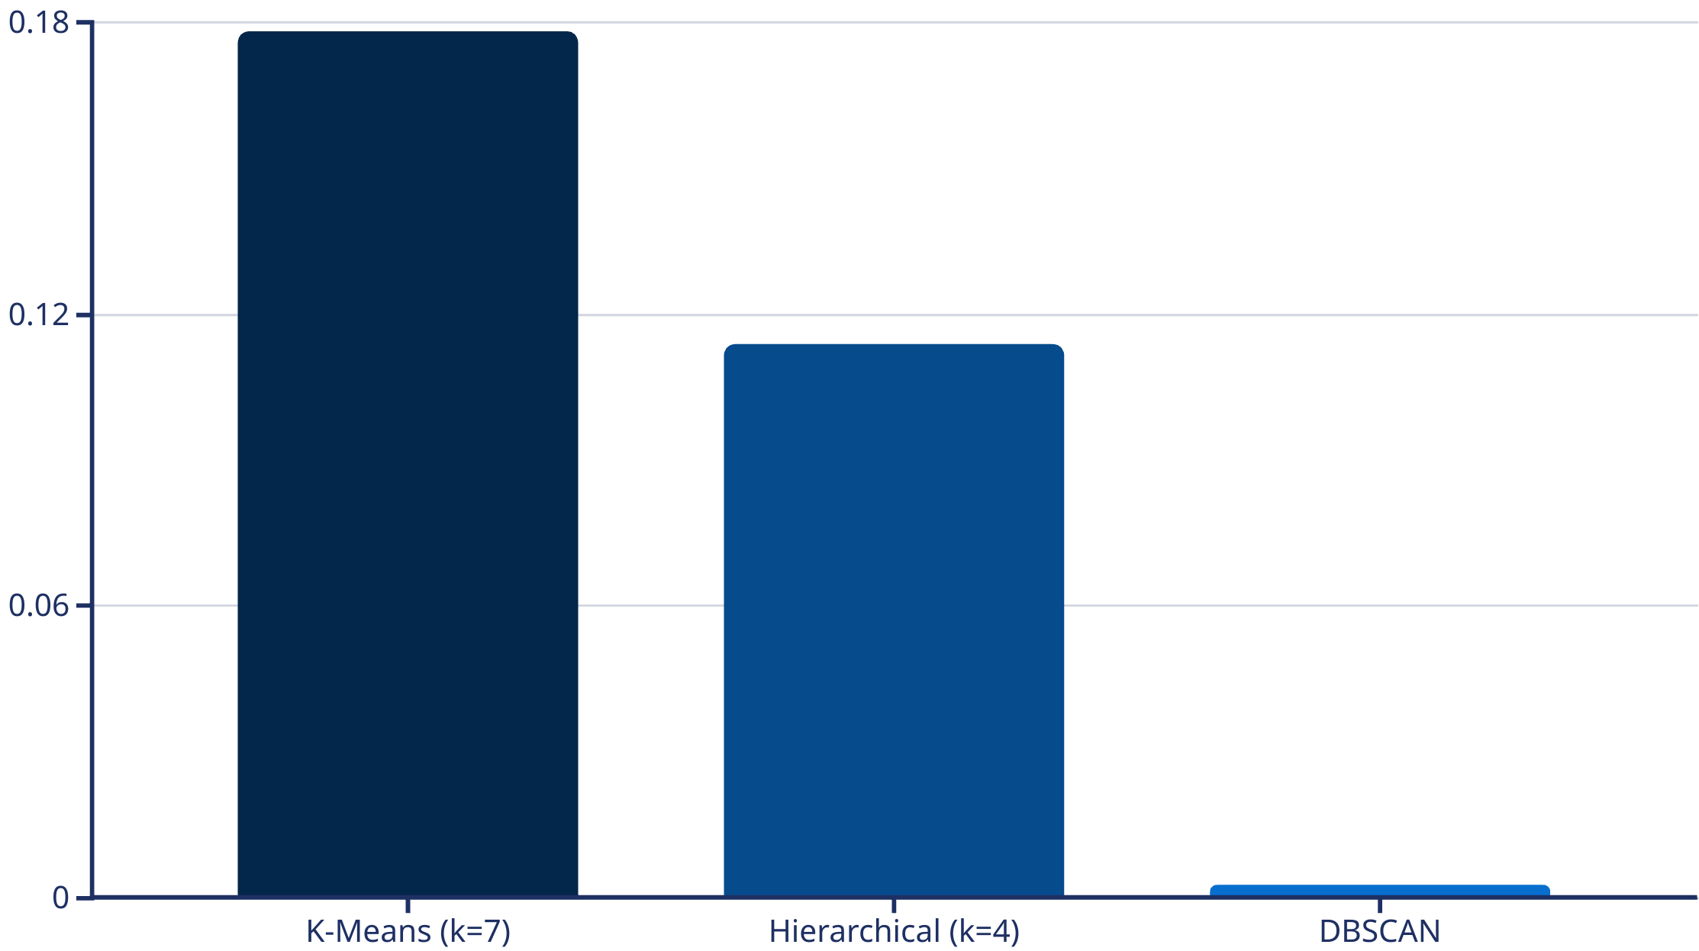
Evaluation Metrics: Quantifying Cluster Quality
Evaluating the quality of the clusters is crucial for determining the most effective segmentation strategy. We primarily relied on Silhouette Scores, a widely used metric that measures how similar an object is to its own cluster compared to other clusters.
The Silhouette Score for K-Means (k=7) was 0.178, indicating a reasonable degree of separation and cohesion within the clusters. Hierarchical Clustering (k=4) yielded a lower score of 0.114, suggesting less distinct clusters. DBSCAN's results were not directly applicable for a meaningful Silhouette Score comparison due to the high number of noise points and the formation of a single dominant cluster, effectively indicating poor segmentation for our dataset. Based on these quantitative evaluations, K-Means was selected as the preferred method for its clearer and more interpretable segmentation of patient wellness profiles.

Slide 9






Sample Cluster Profiles: Diverse Wellness Journeys
Understanding the characteristics of each identified cluster is vital for developing targeted wellness interventions. These sample profiles highlight the diverse lifestyle patterns present within our dataset, offering actionable insights for personalized program design.
Cluster 1: The Balanced & Active
Individuals in this cluster demonstrate a more balanced lifestyle, with 35 minutes of daily exercise, 3 healthy meals, and a robust 7.8 hours of sleep. Their stress levels are moderate (5), and they maintain a healthy BMI of 24. This group might benefit from maintenance programs or advanced wellness strategies.
Cluster 0: The Sedentary & Stressed
This cluster, often representing a group with higher health risks, typically engages in only 20 minutes of exercise daily, consumes just 2 healthy meals, and averages 6.5 hours of sleep. A defining feature is their elevated stress level (7.5) and a higher BMI of 28, indicating a need for comprehensive intervention.
Cluster 2: The Exhausted & Unhealthy
Characterized by very low physical activity (10 min exercise), minimal healthy eating (1 meal), and insufficient sleep (5.5 hrs), this cluster faces significant health challenges. Their stress levels are alarmingly high (8.5), coupled with a high BMI of 31, pointing to an urgent need for foundational health improvements.

Slide 10
PCA Visualization: Unveiling Cluster Separation
Principal Component Analysis (PCA) proved invaluable for visualizing the intricate relationships within our high-dimensional wellness data. By reducing the original five features into two principal components, we were able to plot the data in a 2D space, offering a clearer perspective on the identified clusters.
The reduction to two principal components allowed us to observe the spatial distribution of the patient clusters. Although some overlap was visible, indicating a degree of shared characteristics between certain groups, the visualization clearly revealed distinct groupings.
This visual confirmation is crucial for validating the effectiveness of the clustering techniques and for communicating complex data patterns in an accessible manner to healthcare professionals. It highlights the potential for tailored interventions based on these visually distinct patient profiles.
Each color on the plot represents a different cluster identified by our algorithms, showing how patients with similar wellness profiles tend to congregate in specific regions of the reduced space. This visual separation reinforces the validity of our clustering results, providing an intuitive understanding of the underlying segments within the patient population.

Slide 11
Discussion & Insights
Title: Key Insights from ClusteringBullet Points:
Clusters reveal clear wellness patterns such as high stress with low activity, or balanced health habits.
These groupings can guide healthcare providers in developing more personalized interventions.
DBSCAN’s limited success shows that not all clustering algorithms work well on overlapping lifestyle data.
Despite modest silhouette scores, K-Means segmentation offers practical wellness profiles.

Slide 12
Key Insights from Clustering
Wellness Patterns Emerge
Personalized Interventions
Clusters reveal distinct wellness profiles. Examples include high stress with low activity, or balanced health habits.
These groupings guide healthcare providers. They can now develop more tailored patient support plans.
Algorithm Suitability
Practical Profiles
DBSCAN had limited success. Not all clustering algorithms fit overlapping lifestyle data.
K-Means segmentation delivers valuable insights. Despite modest scores, it yields practical wellness profiles.

Slide 13
Conclusion & Recommendations
Title: Final Thoughts and RecommendationsBullet Points:
Clustering methods, especially K-Means, were effective in identifying patient segments.
PCA simplified the data, making patterns easier to interpret and visualize.
Recommendations:
Add features like age, gender, and chronic conditions.
Use time-series data to track patient progress.
Design customized wellness programs for each identified cluster.

